Slide 1
Business Analytics
Dr. Mehmet Yasin Ulukuş
Lecture 5
Non-Linear Optimization

Slide 2
Non-Linear Optimization
So far, we focused on optimization problems with linear constraints and a linear objective function.
Linear functions are “nice” they are smooth and predictable.
Consequently, we were able to use specialized and highly efficient techniques for their solution.
Many realistic formulations of optimization problems however, do not fit into this nice structure and require more general methods.
There are many problems where the general framework of nonlinear programming is needed.
Training machine learning models involve some form of non linear optimization problem.

Slide 3
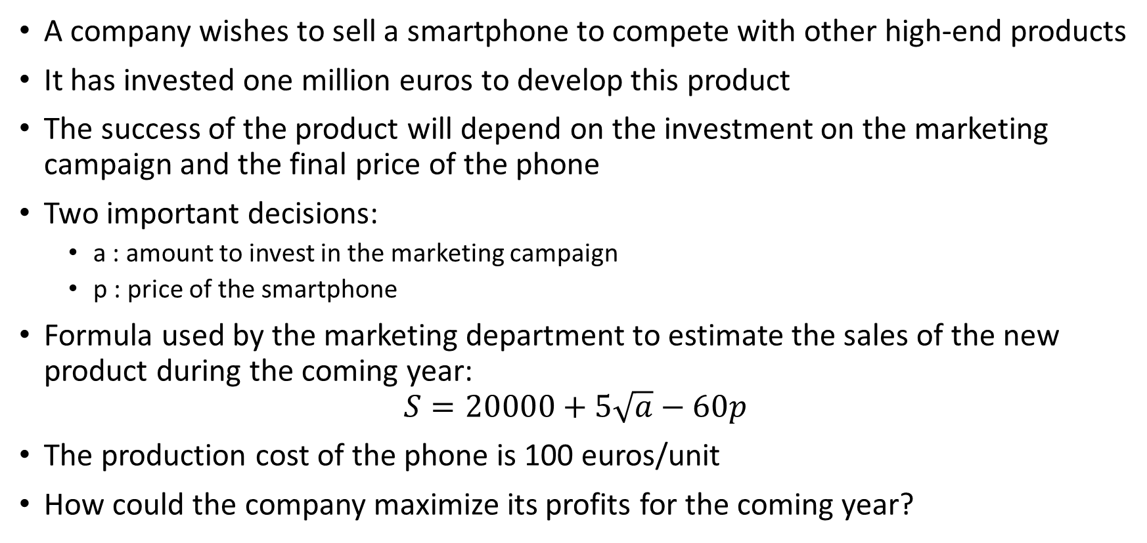
Non-Linear Optimization
A company wishes to sell a smartphone to compete with other high-end products
It has invested one million euros to develop this product
The success of the product will depend on the investment on the marketing campaign and the final price of the phone
Two important decisions:
  a : amount to invest in the marketing campaign
  p : price of the smartphone
Formula used by the marketing department to estimate the sales of the new product during the coming year:
$$S=20000+5\sqrt{a}−60p$$
The production cost of the phone is 100 euros/unit
How could the company maximize its profits for the coming year?

Slide 4
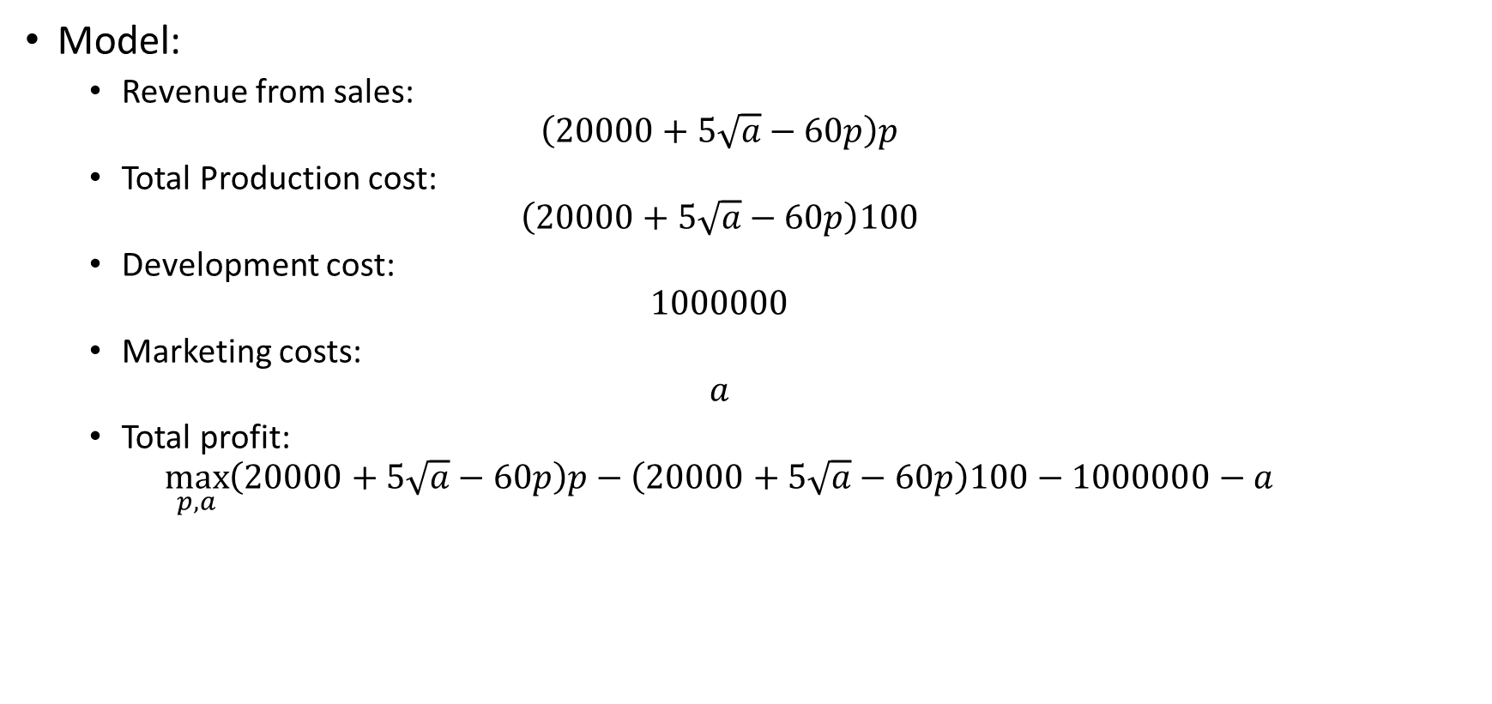
Non-Linear Optimization
Model:
  Revenue from sales:
  $$\left(20000+5\sqrt{a}−60p\right)p$$
  Total Production cost:
  $$\left(20000+5\sqrt{a}−60p\right)100$$
  Development cost:
  $$1000000$$
  Marketing costs:
  $$a$$
  Total profit:
  $$\max_{p,a}\left(20000+5\sqrt{a}−60p\right)p−\left(20000+5\sqrt{a}−60p\right)100−1000000−a$$

Slide 5
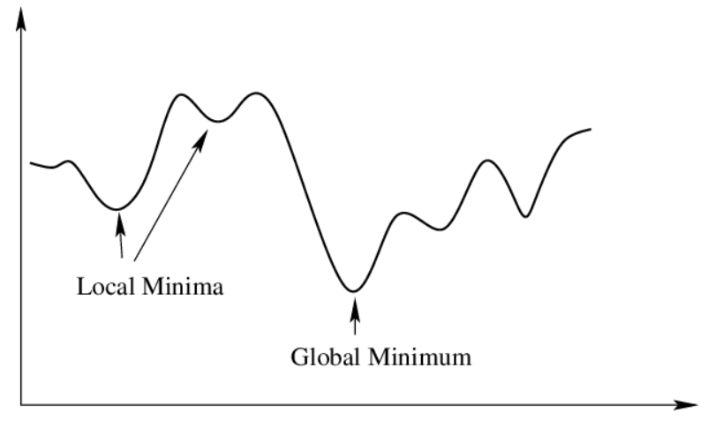
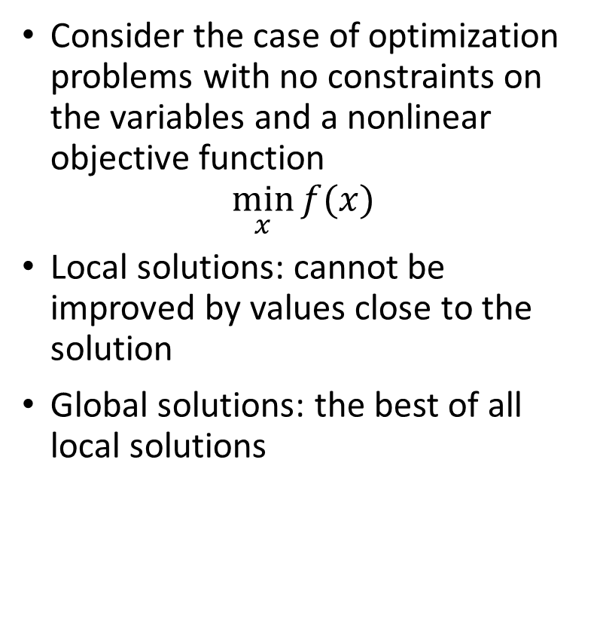
Non-Linear Optimization
Consider the case of optimization problems with no constraints on the variables and a nonlinear objective function
$$\min_{x}{f(x)}$$
Local solutions: cannot be improved by values close to the solution
Global solutions: the best of all local solutions

Slide 6
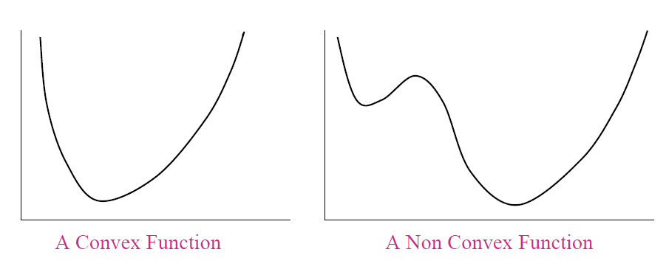
Non-Linear Optimization
Ideal outcome: compute a global solution
In general, it is not possible to find one in a reasonable amount of time
Two alternatives:
  Accept a quick local solution
  Attempt to compute a heuristic approximation to a global solution Or one based on deterministic algorithms if the dimension of the problem is not large
In general, basic versions of optimization solvers are only able to find local solutions
Global solutions only found when some conditions are satisfied: Convexity: local optimizers = global optimizers
Advanced solvers use heuristics to compute approximations to the global optimizers under general conditions without imposing requirements on differentiability, convexity,etc.

Slide 7


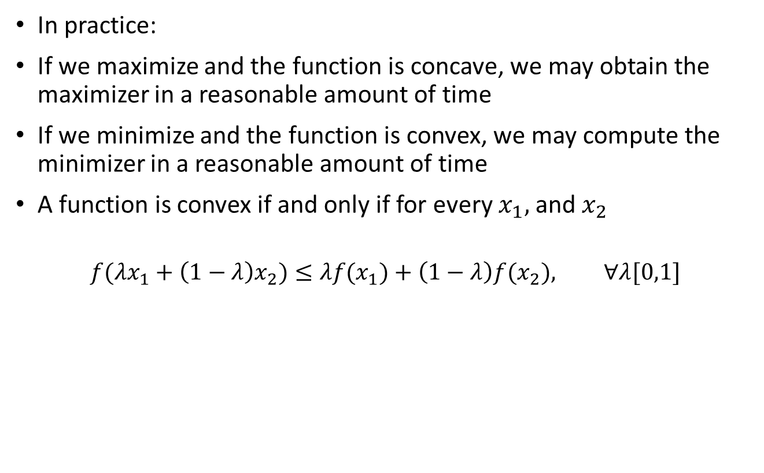



Non-Linear Optimization
In practice:
If we maximize and the function is concave, we may obtain the maximizer in a reasonable amount of time
If we minimize and the function is convex, we may compute the minimizer in a reasonable amount of time
A function is convex if and only if for every $x_{1},$ and $x_{2}$
$$f(λx_{1}+\left(1−λ\right)x_{2})≤λf(x_{1})+\left(1−λ\right)f(x_{2}), ∀λ[0,1]$$
Concave
Convex
$$λf(x_{1})+\left(1−λ\right)f(x_{2})$$
$$f(λx_{1}+\left(1−λ\right)x_{2})$$
$$x_{1}$$
$$x_{2}$$
$$λx_{1}+\left(1−λ\right)x_{2}$$

Slide 8
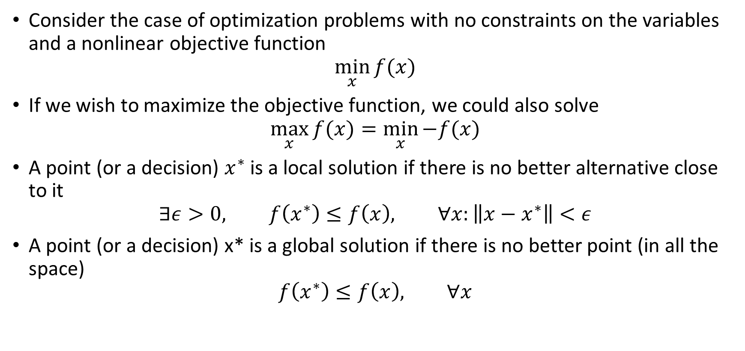
Unconstrained Problem Optimality Conditions
Consider the case of optimization problems with no constraints on the variables and a nonlinear objective function
$$\min_{x}{f(x)}$$
If we wish to maximize the objective function, we could also solve
$$\max_{x}{f(x)}=\min_{x}{−f(x)}$$
A point (or a decision) $x^{∗}$ is a local solution if there is no better alternative close to it
$$∃ε>0, f\left(x^{∗}\right)≤f\left(x\right), ∀x:\left\|x−x^{∗}\right\|<ε$$
A point (or a decision) x* is a global solution if there is no better point (in all the space)
$$f\left(x^{∗}\right)≤f\left(x\right), ∀x$$

Slide 9
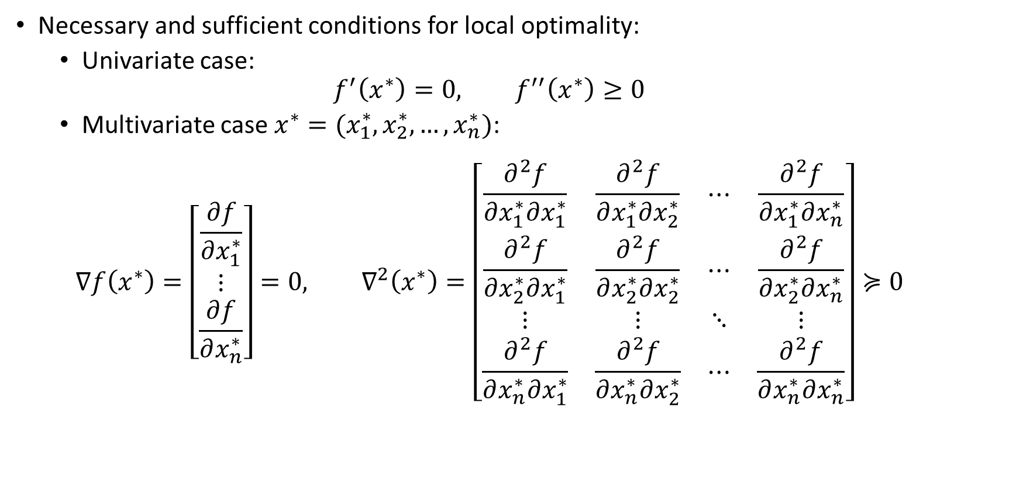
Unconstrained Problem Optimality Conditions
Necessary and sufficient conditions for local optimality:
  Univariate case:
  $$f^{′}\left(x^{∗}\right)=0, f^{′′}\left(x^{∗}\right)≥0$$
  Multivariate case $x^{∗}=(x_{1}^{∗},x_{2}^{∗},…,x_{n}^{∗})$:
  $$∇f\left(x^{∗}\right)=\left[\begin{matrix}\frac{∂f}{∂x_{1}^{∗}} \\ ⋮ \\ \frac{∂f}{∂x_{n}^{∗}}\end{matrix}\right]=0, ∇^{2}\left(x^{∗}\right)=\left[\begin{matrix}\frac{∂^{2}f}{∂x_{1}^{∗}∂x_{1}^{∗}} & \frac{∂^{2}f}{∂x_{1}^{∗}∂x_{2}^{∗}} & ⋯ & \frac{∂^{2}f}{∂x_{1}^{∗}∂x_{n}^{∗}} \\ \frac{∂^{2}f}{∂x_{2}^{∗}∂x_{1}^{∗}} & \frac{∂^{2}f}{∂x_{2}^{∗}∂x_{2}^{∗}} & ⋯ & \frac{∂^{2}f}{∂x_{2}^{∗}∂x_{n}^{∗}} \\ ⋮ & ⋮ & ⋱ & ⋮ \\ \frac{∂^{2}f}{∂x_{n}^{∗}∂x_{1}^{∗}} & \frac{∂^{2}f}{∂x_{n}^{∗}∂x_{2}^{∗}} & ⋯ & \frac{∂^{2}f}{∂x_{n}^{∗}∂x_{n}^{∗}}\end{matrix}\right]≽0$$

Slide 10
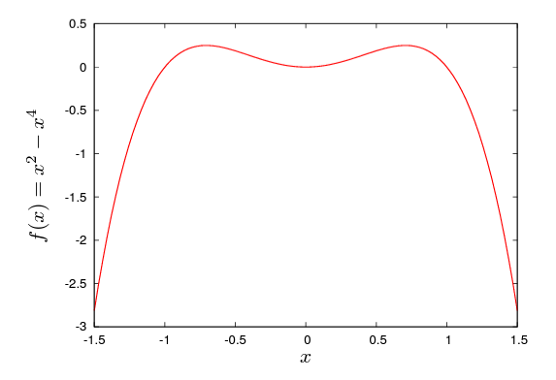
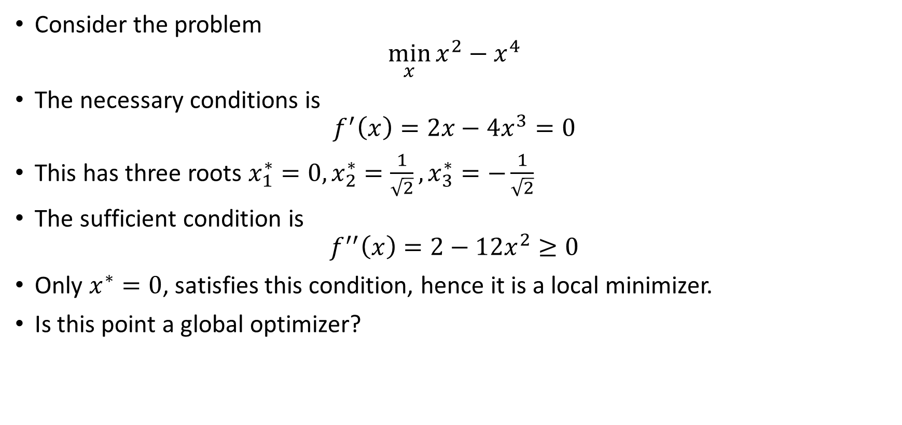
Unconstrained Problem Optimality Conditions
Consider the problem
$$\min_{x}{x^{2}−x^{4}}$$
The necessary conditions is
$$f^{′}\left(x\right)=2x−4x^{3}=0$$
This has three roots $x_{1}^{∗}=0, x_{2}^{∗}=\frac{1}{\sqrt{2}}, x_{3}^{∗}=−\frac{1}{\sqrt{2}}$
The sufficient condition is
$$f^{′′}\left(x\right)=2−12x^{2}≥0$$
Only $x^{∗}=0$, satisfies this condition, hence it is a local minimizer.
Is this point a global optimizer?

Slide 11
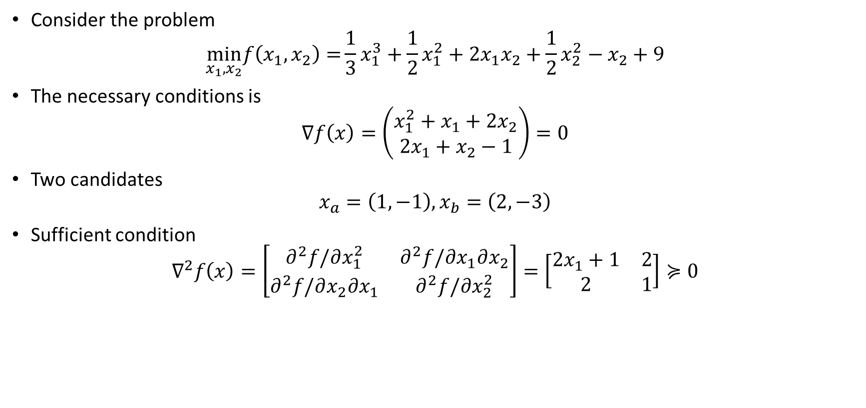
Unconstrained Problem Optimality Conditions
Consider the problem
$$\min_{x_{1},x_{2}}f\left(x_{1},x_{2}\right)={\frac{1}{3}x_{1}^{3}+\frac{1}{2}x_{1}^{2}+2x_{1}x_{2}+\frac{1}{2}x_{2}^{2}−x_{2}+9}$$
The necessary conditions is
$$∇f\left(x\right)=\left(\begin{matrix}x_{1}^{2}+x_{1}+2x_{2} \\ 2x_{1}+x_{2}−1\end{matrix}\right)=0$$
Two candidates
$$x_{a}=\left(1,−1\right), x_{b}=\left(2,−3\right)$$
Sufficient condition
$$∇^{2}f\left(x\right)=\left[\begin{matrix}∂^{2}f/∂x_{1}^{2} & ∂^{2}f/∂x_{1}∂x_{2} \\ ∂^{2}f/∂x_{2}∂x_{1} & ∂^{2}f/∂x_{2}^{2}\end{matrix}\right]=\left[\begin{matrix}2x_{1}+1 & 2 \\ 2 & 1\end{matrix}\right]≽0$$

Slide 12
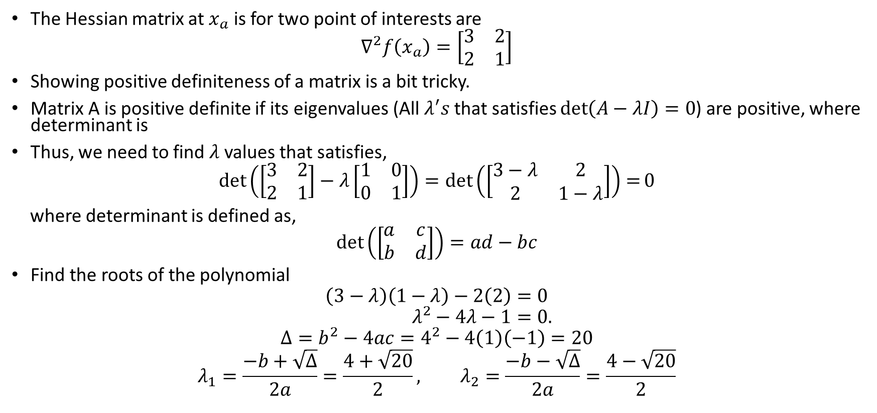
Unconstrained Problem Optimality Conditions
The Hessian matrix at $x_{a}$ is for two point of interests are
$$∇^{2}f\left(x_{a}\right)=\left[\begin{matrix}3 & 2 \\ 2 & 1\end{matrix}\right]$$
Showing positive definiteness of a matrix is a bit tricky.
Matrix A is positive definite if its eigenvalues (All $λ^{′}s$that satisfies $\det\left(A−λI\right)=0$) are positive, where determinant is
Thus, we need to find $λ$ values that satisfies,
$$\det\left(\left[\begin{matrix}3 & 2 \\ 2 & 1\end{matrix}\right]−λ\left[\begin{matrix}1 & 0 \\ 0 & 1\end{matrix}\right]\right)=\det\left(\left[\begin{matrix}3−λ & 2 \\ 2 & 1−λ\end{matrix}\right]\right)=0$$
where determinant is defined as,
$$\det\left(\left[\begin{matrix}a & c \\ b & d\end{matrix}\right]\right)=ad−bc$$
Find the roots of the polynomial
$$\left(3−λ\right)\left(1−λ\right)−2\left(2\right)=0 \\ λ^{2}−4λ−1=0.$$
$$Δ=b^{2}−4ac=4^{2}−4\left(1\right)\left(−1\right)=20$$
$$λ_{1}=\frac{−b+\sqrt{Δ}}{2a}=\frac{4+\sqrt{20}}{2}, λ_{2}=\frac{−b−\sqrt{Δ}}{2a}=\frac{4−\sqrt{20}}{2}$$
Negative

Slide 13
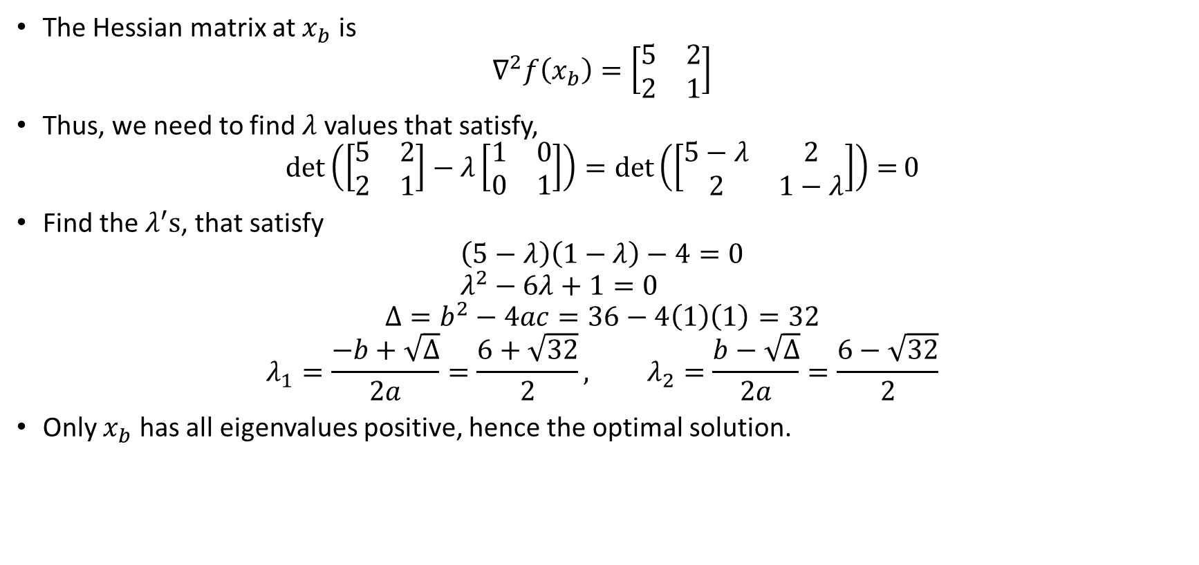
Unconstrained Problem Optimality Conditions
The Hessian matrix at $x_{b}$ is
$$∇^{2}f\left(x_{b}\right)=\left[\begin{matrix}5 & 2 \\ 2 & 1\end{matrix}\right]$$
Thus, we need to find $λ$ values that satisfy,
$$\det\left(\left[\begin{matrix}5 & 2 \\ 2 & 1\end{matrix}\right]−λ\left[\begin{matrix}1 & 0 \\ 0 & 1\end{matrix}\right]\right)=\det\left(\left[\begin{matrix}5−λ & 2 \\ 2 & 1−λ\end{matrix}\right]\right)=0$$
Find the $λ^{′}s$, that satisfy
$$\left(5−λ\right)\left(1−λ\right)−4=0 \\ λ^{2}−6λ+1=0$$
$$Δ=b^{2}−4ac=36−4\left(1\right)\left(1\right)=32$$
$$λ_{1}=\frac{−b+\sqrt{Δ}}{2a}=\frac{6+\sqrt{32}}{2}, λ_{2}=\frac{b−\sqrt{Δ}}{2a}=\frac{6−\sqrt{32}}{2}$$
Only $x_{b}$ has all eigenvalues positive, hence the optimal solution.

Slide 14
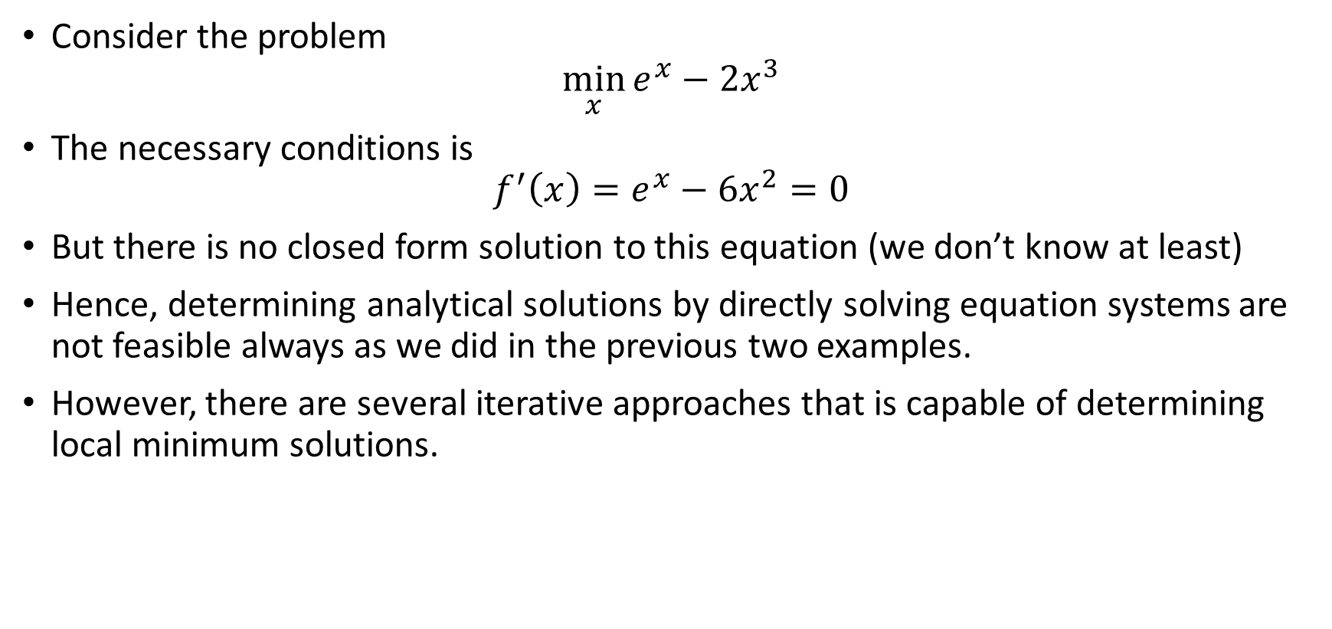
Unconstrained Problem Optimality Conditions
Consider the problem
$$\min_{x}{e^{x}−2x^{3}}$$
The necessary conditions is
$$f^{′}\left(x\right)=e^{x}−6x^{2}=0$$
But there is no closed form solution to this equation (we don’t know at least)
Hence, determining analytical solutions by directly solving equation systems are not feasible always as we did in the previous two examples.
However, there are several iterative approaches that is capable of determining local minimum solutions.

Slide 15


Iterative Solutions: Steepest Descent
This is a general purpose optimization algorithm.
Most algorithms are iterative and descending
A blind person finds himself in a valley and wants to get into the bottom of the valley
He checks his neighborhood, and takes a step in the direction of downward
Again he checks his neighborhood and finds the direction of downward and takes a step in that direction
He goes down until no neighborhood is has a downward direction
$$f(x)$$
$$x$$

Slide 16

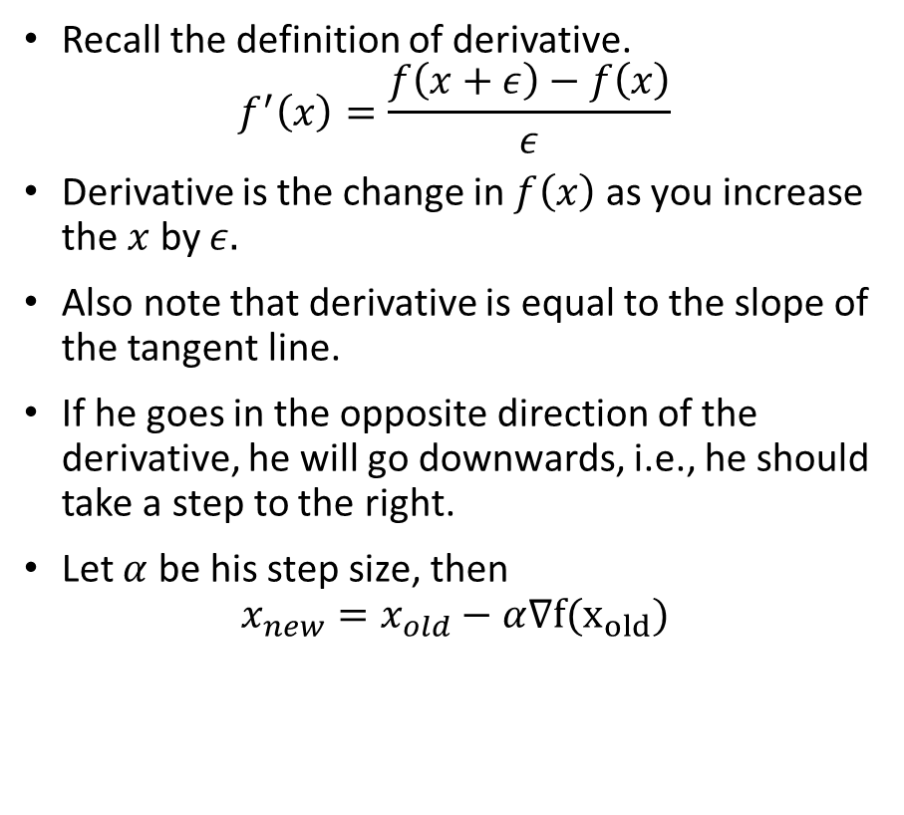
Iterative Solutions: Steepest Descent
Recall the definition of derivative.
$$f^{′}\left(x\right)=\frac{f\left(x+ε\right)−f\left(x\right)}{ε}$$
Derivative is the change in $f\left(x\right)$ as you increase the $x$ by $ε.$
Also note that derivative is equal to the slope of the tangent line.
If he goes in the opposite direction of the derivative, he will go downwards, i.e., he should take a step to the right.
Let $α$ be his step size, then
$$x_{new}=x_{old}−α∇f(x_{old})$$
$$f(x)$$
$$x$$

Slide 17
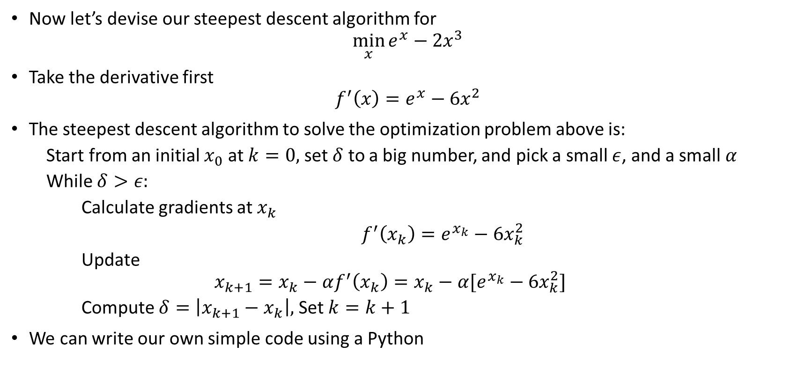
Iterative Solutions: Steepest Descent
Now let’s devise our steepest descent algorithm for
$$\min_{x}{e^{x}−2x^{3}}$$
Take the derivative first
$$f^{′}\left(x\right)=e^{x}−6x^{2}$$
The steepest descent algorithm to solve the optimization problem above is:
  Start from an initial $x_{0}$ at $k=0,$ set $δ$ to a big number, and pick a small $ε$, and a small $α$
  While $δ>ε:$
    Calculate gradients at $x_{k}$
  $f^{′}\left(x_{k}\right)=e^{x_{k}}−6x_{k}^{2}$
  Update
  $$x_{k+1}=x_{k}−αf^{′}\left(x_{k}\right)=x_{k}−α[e^{x_{k}}−6x_{k}^{2}]$$
  Compute $δ=\left|x_{k+1}−x_{k}\right|,$ Set $k=k+1$
We can write our own simple code using a Python

Slide 18
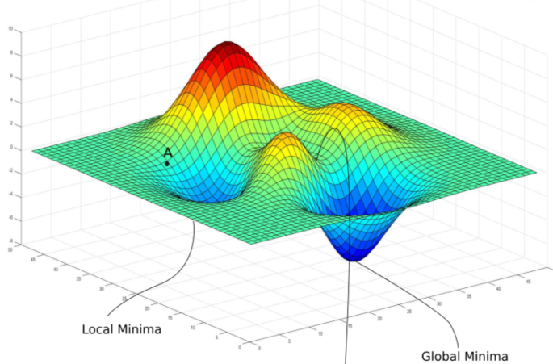
Iterative Solutions
This algorithm will only obtain a local minimum.
Depending on your initial point, you may obtain different local minimum solutions.
We prefer running algorithms from random initial starting points and pick the best one (still no guarantee)

Slide 19
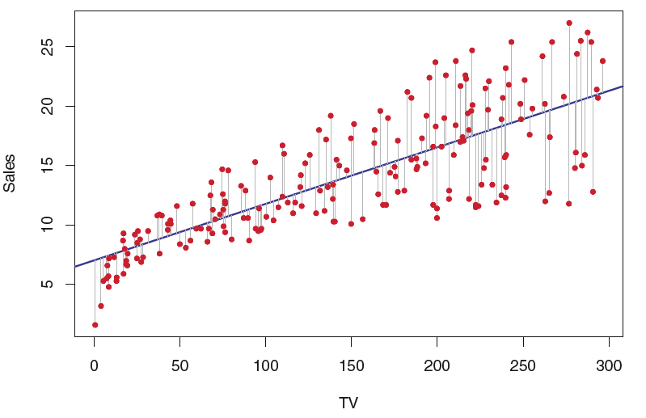
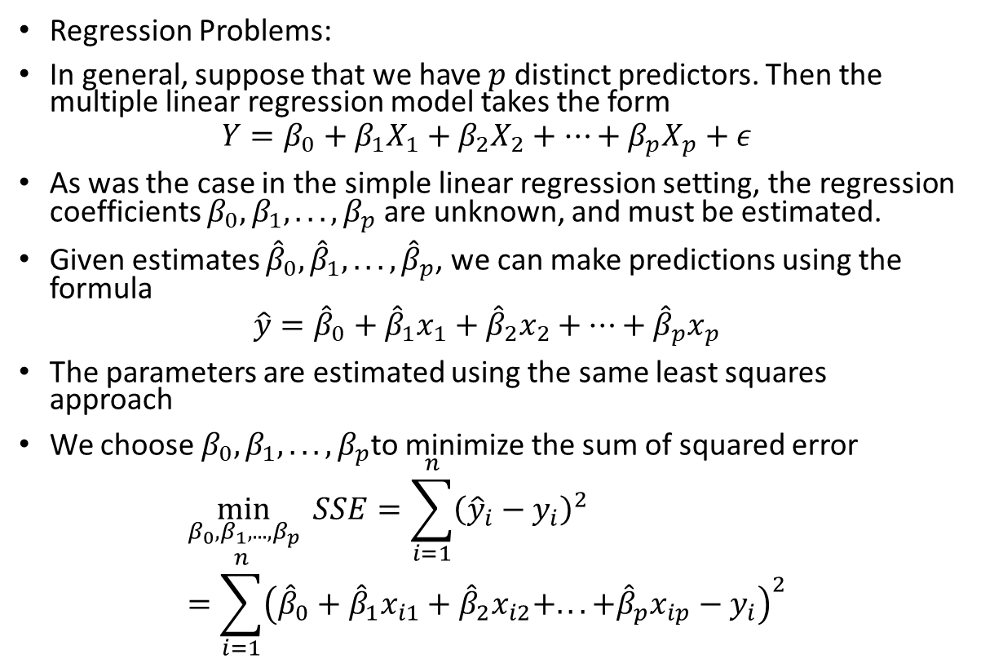
Non-Linear Optimization: Example 2
Regression Problems:
In general, suppose that we have $p$ distinct predictors. Then the multiple linear regression model takes the form
$$Y=β_{0}+β_{1}X_{1}+β_{2}X_{2}+…+β_{p}X_{p}+ε$$
As was the case in the simple linear regression setting, the regression coefficients $β_{0}, β_{1}, . . . , β_{p}$ are unknown, and must be estimated.
Given estimates ${\hat{β}}_{0},{\hat{β}}_{1}, . . . ,{\hat{β}}_{p}$, we can make predictions using the formula
$$\hat{y}={\hat{β}}_{0}+{\hat{β}}_{1}x_{1}+{\hat{β}}_{2}x_{2}+…+{\hat{β}}_{p}x_{p}$$
The parameters are estimated using the same least squares approach
We choose $β_{0}, β_{1}, . . . , β_{p}$to minimize the sum of squared error
$$\min_{β_{0}, β_{1}, . . . , β_{p}}{SSE}=\sum_{i=1}^{n}{{\left({\hat{y}}_{i}−y_{i}\right)}^{2}}=\sum_{i=1}^{n}{{\left({\hat{β}}_{0}+{\hat{β}}_{1}x_{i1}+{\hat{β}}_{2}x_{i2}+. . . +{\hat{β}}_{p}x_{ip}−y_{i}\right)}^{2}}$$
Y
X

Slide 20
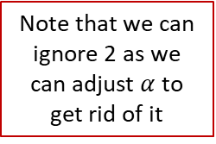
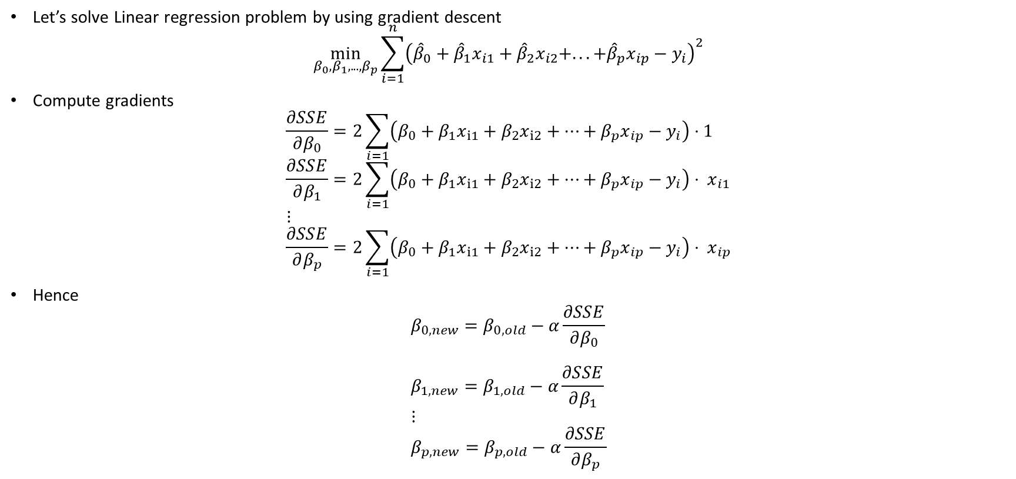
Gradient Descent for Least Square
Let’s solve Linear regression problem by using gradient descent
$$\min_{β_{0}, β_{1}, . . . , β_{p}}\sum_{i=1}^{n}{{\left({\hat{β}}_{0}+{\hat{β}}_{1}x_{i1}+{\hat{β}}_{2}x_{i2}+. . . +{\hat{β}}_{p}x_{ip}−y_{i}\right)}^{2}}$$
Compute gradients
$$\frac{∂SSE}{∂β_{0}}=2\sum_{i=1}{\left(β_{0}+β_{1}x_{i1}+β_{2}x_{i2}+…+β_{p}x_{ip}−y_{i}\right)}⋅1 \\ \frac{∂SSE}{∂β_{1}}=2\sum_{i=1}{\left(β_{0}+β_{1}x_{i1}+β_{2}x_{i2}+…+β_{p}x_{ip}−y_{i}\right)}⋅ x_{i1} \\ ⋮ \\ \frac{∂SSE}{∂β_{p}}=2\sum_{i=1}{\left(β_{0}+β_{1}x_{i1}+β_{2}x_{i2}+…+β_{p}x_{ip}−y_{i}\right)}⋅ x_{ip}$$
Hence
$$β_{0,new}=β_{0,old}−α\frac{∂SSE}{∂β_{0}} \\ β_{1,new}=β_{1,old}−α\frac{∂SSE}{∂β_{1}} \\ ⋮ \\ β_{p,new}=β_{p,old}−α\frac{∂SSE}{∂β_{p}}$$
Note that we can ignore 2 as we can adjust $α$ to get rid of it

Slide 21
Gradient Descent for Least Square
Randomly initialize parameters
Calculate SSE values with given parameters
Calculate gradients
Update parameters given gradients
Repeat steps 2-4
A solution obtained by the gradient descent for the linear regression problem is global optimum, because SSE is a convex function.

Slide 22
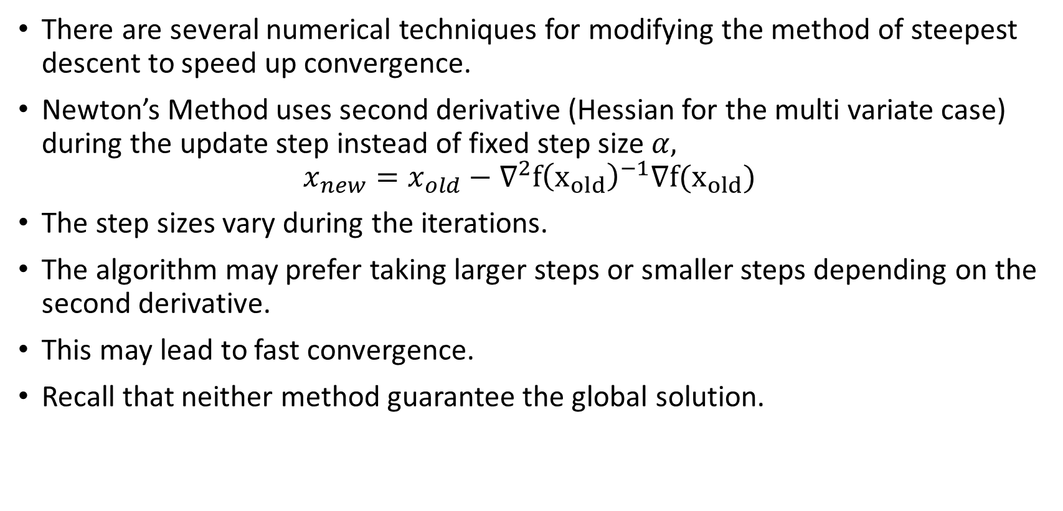
Iterative Solutions: Newton’s Method
There are several numerical techniques for modifying the method of steepest descent to speed up convergence.
Newton’s Method uses second derivative (Hessian for the multi variate case) during the update step instead of fixed step size $α,$
$$x_{new}=x_{old}−∇^{2}f{\left(x_{old}\right)}^{−1}∇f(x_{old})$$
The step sizes vary during the iterations.
The algorithm may prefer taking larger steps or smaller steps depending on the second derivative.
This may lead to fast convergence.
Recall that neither method guarantee the global solution.

Slide 23
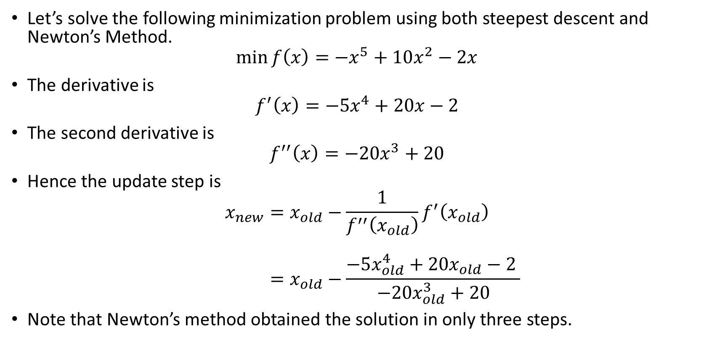
Iterative Solutions: Newton’s Method
Let’s solve the following minimization problem using both steepest descent and Newton’s Method.
$$\min{f\left(x\right)=−x^{5}+10x^{2}−2x}$$
The derivative is
$$f^{′}\left(x\right)=−5x^{4}+20x−2$$
The second derivative is
$$f^{′′}\left(x\right)=−20x^{3}+20$$
Hence the update step is
$$x_{new}=x_{old}−\frac{1}{f^{′′}\left(x_{old}\right)}f^{′}\left(x_{old}\right) \\ =x_{old}−\frac{−5x_{old}^{4}+20x_{old}−2 }{−20x_{old}^{3}+20}$$
Note that Newton’s method obtained the solution in only three steps.

Slide 24
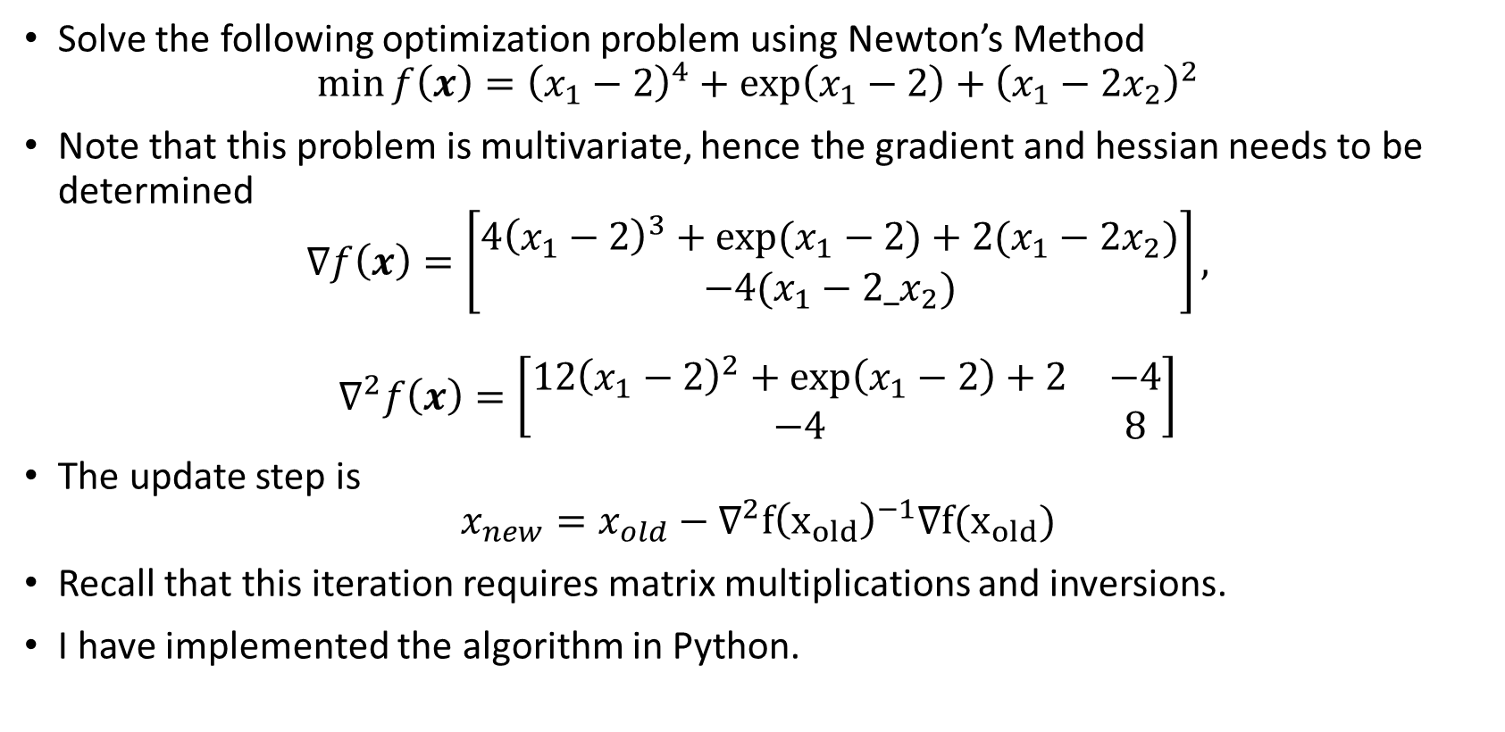
Iterative Solutions: Newton’s Method
Solve the following optimization problem using Newton’s Method
$$\min{f\left(x\right)={\left(x_{1}−2\right)}^{4}+\exp\left(x_{1}−2\right)+{\left(x_{1}−2x_{2}\right)}^{2}}$$
Note that this problem is multivariate, hence the gradient and hessian needs to be determined
$$∇f\left(x\right)=\left[\begin{matrix}4{\left(x_{1}−2\right)}^{3}+\exp{(x_{1}−2)}+2(x_{1}−2x_{2}) \\ −4(x_{1}−2_x_{2})\end{matrix}\right],$$
$$∇^{2}f\left(x\right)=\left[\begin{matrix}12{\left(x_{1}−2\right)}^{2}+\exp\left(x_{1}−2\right)+2 & −4 \\ −4 & 8\end{matrix}\right]$$
The update step is
$$x_{new}=x_{old}−∇^{2}f{\left(x_{old}\right)}^{−1}∇f(x_{old})$$
Recall that this iteration requires matrix multiplications and inversions.
I have implemented the algorithm in Python.

Slide 25
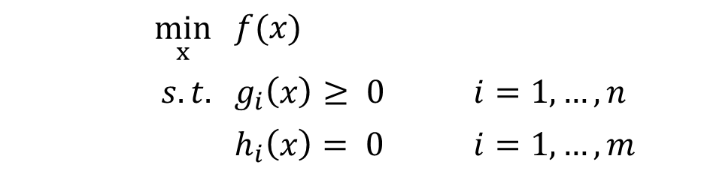
Constrained Problem
If we allow constraints, the problem is now:
We consider the case when either the objective function or the constraints are nonlinear functions
The optimizers may have significantly different properties than those corresponding to unconstrained problems
Local solution: belongs to the feasible region and it cannot be improved in a feasible neighborhood of the solution
Global solution: belongs to the feasible region, and is the best of all local solutions
$$\min_{x}$$ | $$f(x)$$
$$s.t.$$ | $$g_{i}\left(x\right)≥ 0$$ | $$i=1,…,n$$
 | $$h_{i}\left(x\right)= 0$$ | $$i=1,…,m$$

Slide 26
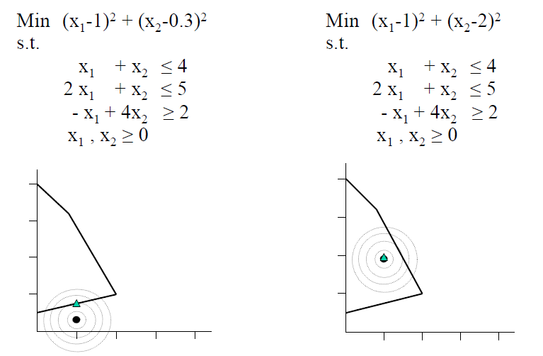
Constrained Problem
Differences with linear problems
  Solutions do not need to be at vertices
If the problem is not convex, the solution found by the Solver may only be a local solution (not a global one)
Very difficult to check formally
Heuristic: You can try to solve the problem from different starting points

Slide 27
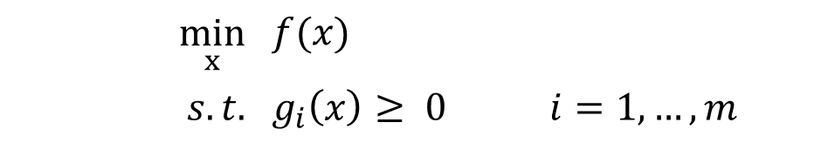
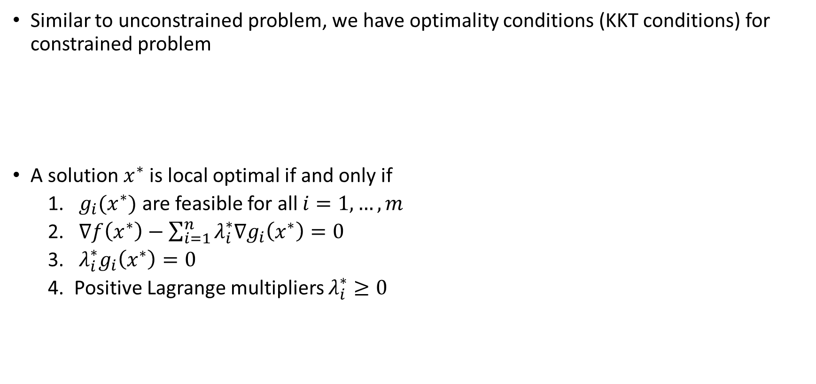
KKT Optimality Conditions
Similar to unconstrained problem, we have optimality conditions (KKT conditions) for constrained problem
A solution $x^{∗}$is local optimal if and only if
  $g_{i}(x^{∗})$ are feasible for all $i=1,…,m$
  $∇f\left(x^{∗}\right)−\sum_{i=1}^{n}{λ_{i}^{∗}∇g_{i}\left(x^{∗}\right)}=0$
  $λ_{i}^{∗}g_{i}\left(x^{∗}\right)=0$
  Positive Lagrange multipliers $λ_{i}^{∗}≥0$
$$\min_{x}$$ | $$f(x)$$
$$s.t.$$ | $$g_{i}\left(x\right)≥ 0$$ | $$i=1,…,m$$

Slide 28
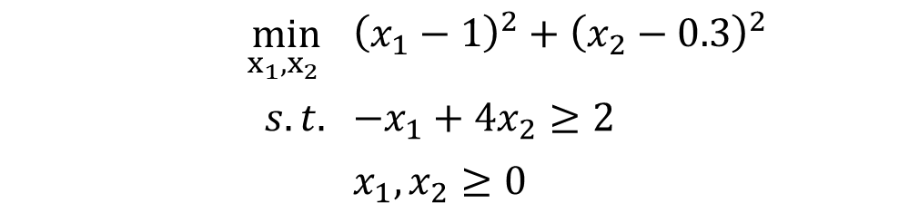
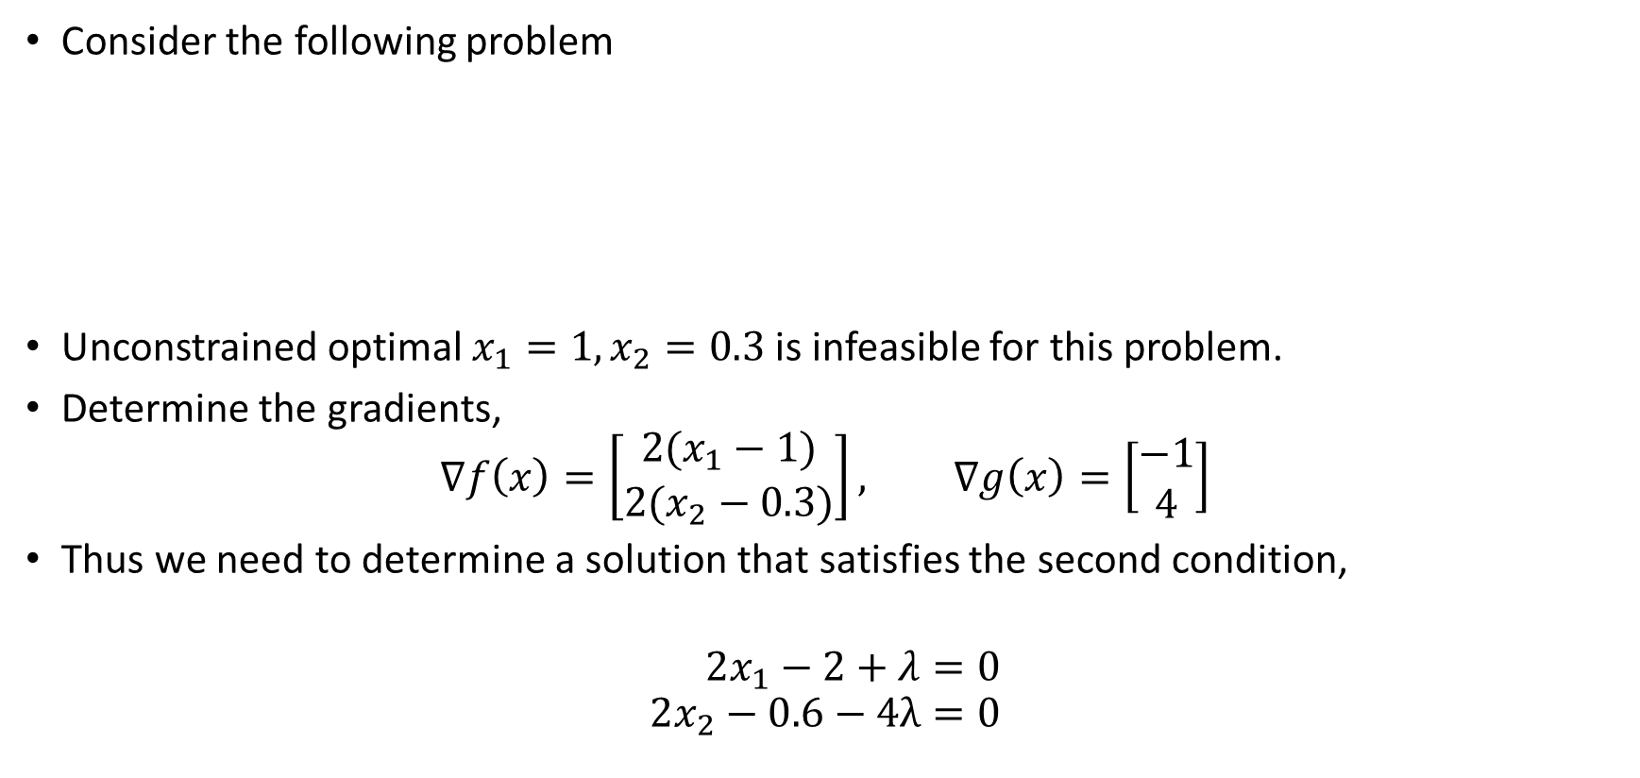
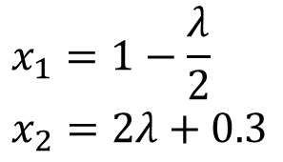
KKT Optimality Conditions: Example 1
Consider the following problem
Unconstrained optimal $x_{1}=1,x_{2}=0.3$ is infeasible for this problem.
Determine the gradients,
$$∇f\left(x\right)=\left[\begin{matrix}2(x_{1}−1) \\ 2(x_{2}−0.3)\end{matrix}\right], ∇g\left(x\right)=\left[\begin{matrix}−1 \\ 4\end{matrix}\right]$$
Thus we need to determine a solution that satisfies the second condition,
$$2x_{1}−2+λ=0 \\ 2x_{2}−0.6−4λ=0$$
$$\min_{x_{1},x_{2} }$$ | $${\left(x_{1}−1\right)}^{2}+{\left(x_{2}−0.3\right)}^{2}$$
$$s.t.$$ | $$−x_{1}+4x_{2}≥2$$
 | $$x_{1},x_{2}≥0$$
$$x_{1}=1−\frac{λ}{2} \\ x_{2}=2λ+0.3$$

Slide 29
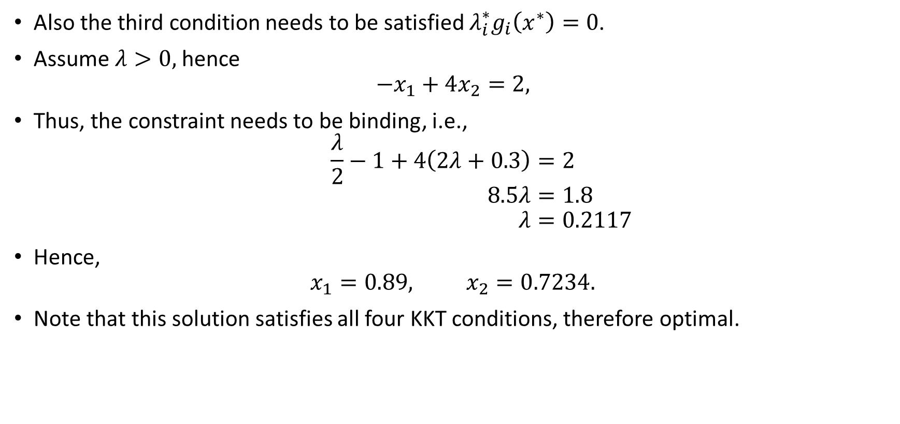
KKT Optimality Conditions: Example 1
Also the third condition needs to be satisfied $λ_{i}^{∗}g_{i}\left(x^{∗}\right)=0$.
Assume $λ>0,$ hence
$$−x_{1}+4x_{2}=2,$$
Thus, the constraint needs to be binding, i.e.,
$$\frac{λ}{2}−1+4\left(2λ+0.3\right)=2 \\ 8.5λ=1.8 \\ λ=0.2117$$
Hence,
$$x_{1}=0.89, x_{2}=0.7234.$$
Note that this solution satisfies all four KKT conditions, therefore optimal.

Slide 30
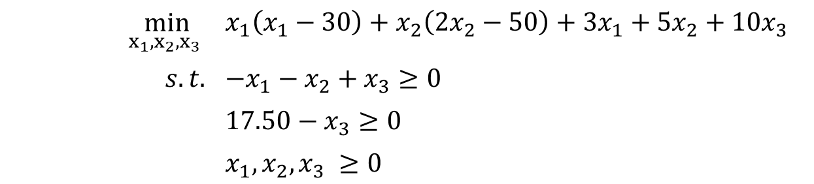
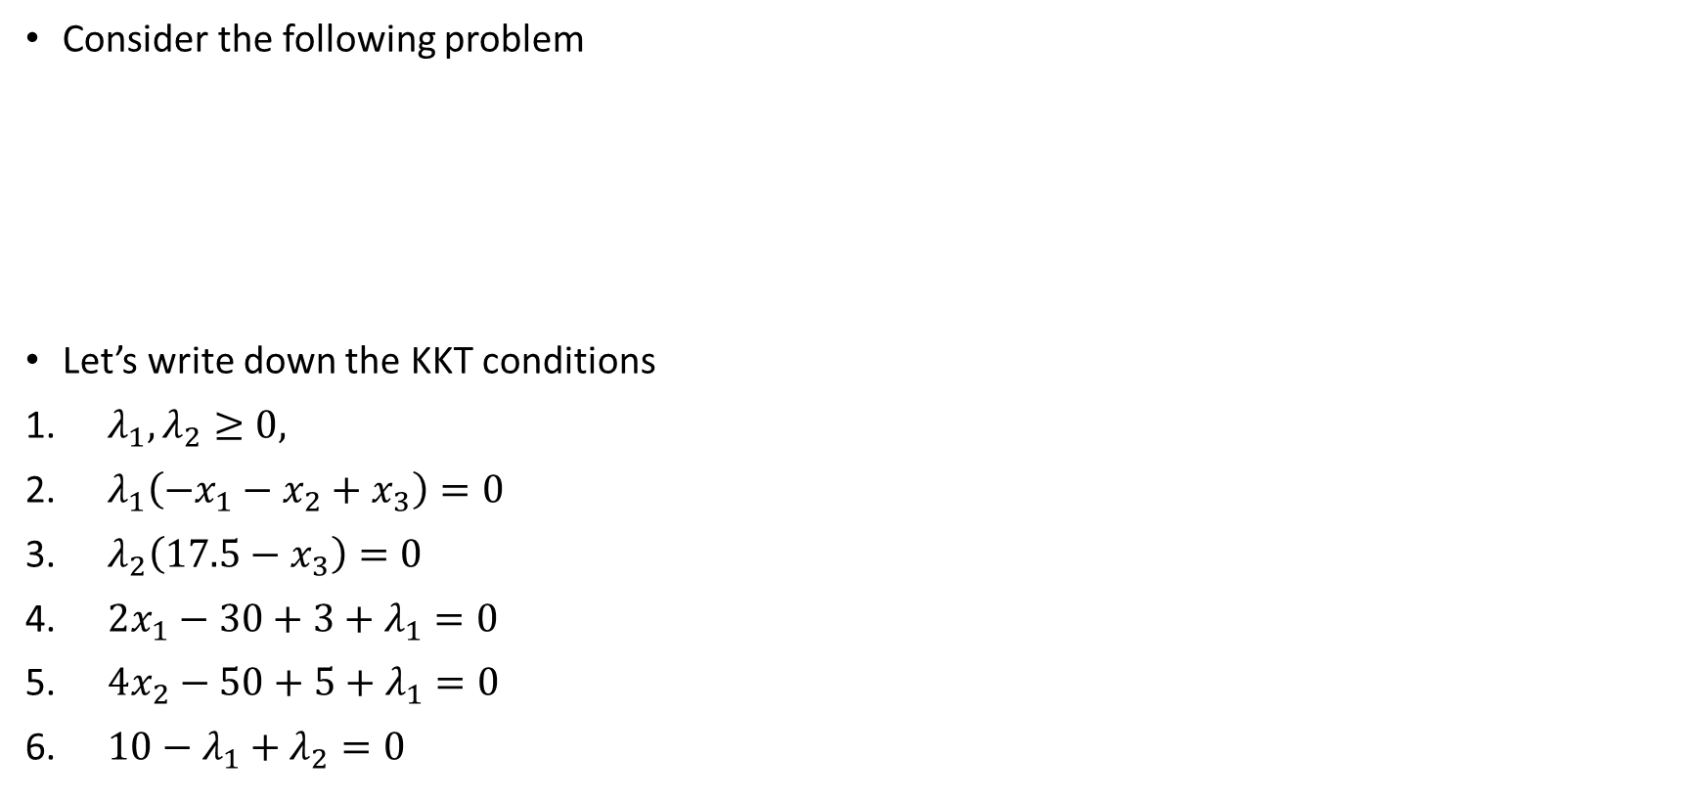
KKT Optimality Conditions: Example 2
Consider the following problem
Let’s write down the KKT conditions
$λ_{1},λ_{2}≥0,$
$λ_{1}\left(−x_{1}−x_{2}+x_{3}\right)=0$
$λ_{2}\left(17.5−x_{3}\right)=0$
$2x_{1}−30+3+λ_{1}=0$
$4x_{2}−50+5+λ_{1}=0$
$10−λ_{1}+λ_{2}=0$
$$\min_{x_{1},x_{2},x_{3} }$$ | $$x_{1}\left(x_{1}−30\right)+x_{2}\left(2x_{2}−50\right)+3x_{1}+5x_{2}+10x_{3}$$
$$s.t.$$ | $$−x_{1}−x_{2}+x_{3}≥0$$
 | $$17.50−x_{3}≥0$$
 | $$x_{1},x_{2},x_{3} ≥0$$

Slide 31
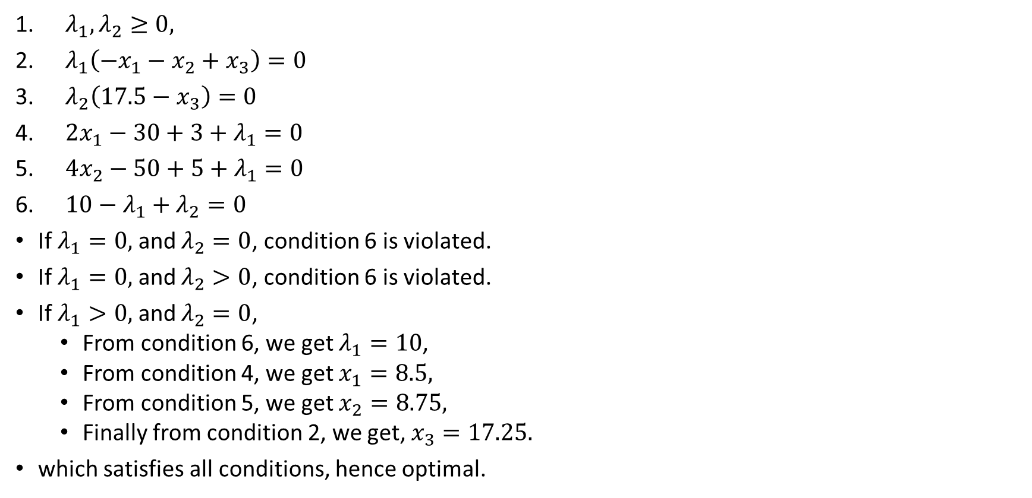
KKT Optimality Conditions: Example 2
$λ_{1},λ_{2}≥0,$
$λ_{1}\left(−x_{1}−x_{2}+x_{3}\right)=0$
$λ_{2}\left(17.5−x_{3}\right)=0$
$2x_{1}−30+3+λ_{1}=0$
$4x_{2}−50+5+λ_{1}=0$
$10−λ_{1}+λ_{2}=0$
If $λ_{1}=0,$ and $λ_{2}=0$, condition 6 is violated.
If $λ_{1}=0,$ and $λ_{2}>0$, condition 6 is violated.
If $λ_{1}>0,$ and $λ_{2}=0$,
  From condition 6, we get $λ_{1}=10$,
  From condition 4, we get $x_{1}=8.5,$
  From condition 5, we get $x_{2}=8.75,$
  Finally from condition 2, we get, $x_{3}=17.25.$
which satisfies all conditions, hence optimal.

Slide 32
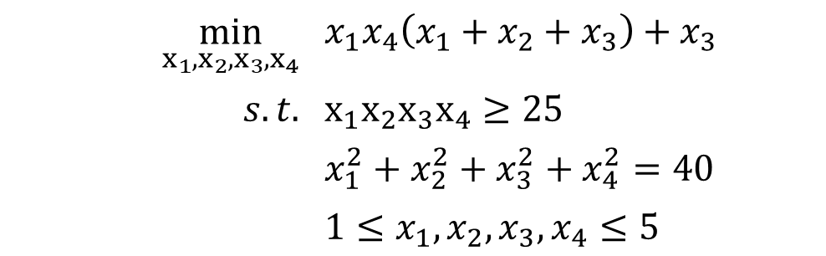
Scipy Optimize
Generally not easy to find solutions that satisfies the above conditions, hence we rely on iterative solutions.
Scipy optimize is a reliable solver for non-linear programming problems.
Let’s solve the following problem
$$\min_{x_{1},x_{2},x_{3},x_{4}}$$ | $$x_{1}x_{4}\left(x_{1}+x_{2}+x_{3}\right)+x_{3}$$
$$s.t.$$ | $$x_{1}x_{2}x_{3}x_{4}≥25$$
 | $$x_{1}^{2}+x_{2}^{2}+x_{3}^{2}+x_{4}^{2}=40$$
 | $$1≤x_{1},x_{2},x_{3},x_{4}≤5$$

